Slide 1
Voice-Enabled Text Reader for Visually Impaired
Dr. V. Mohan
Mentor:
Team members:
1. Balaji S D - 813821106013
2. Bharani Dharan K - 813821106015
3. Divakaran J - 813821106022
4. Guru Venkatesh S - 813821106036

Slide 2
Problem Statement:
Visually impaired individuals face significant challenges in accessing
1.Written text( like educational materials and documents),
2.Everyday information such as menus, signage, and product labels.
Existing solutions like Braille or audiobooks often fall short in terms of accessibility, affordability, and real-time usability.
To bridge this gap, a voice-enabled text reader leveraging modern technology can capture printed or handwritten text, process it efficiently, and convert it into audio output in real time. Such a system would empower visually impaired individuals to independently interact with written content, enhancing their quality of life and access to information.

Slide 3
Existing Solution:
1.OCR & TTS Using Tesseract and eSpeak
Uses: Tesseract OCR for text recognition and eSpeak for speech synthesis.
Disadvantages: Lower OCR accuracy with handwritten text and complex fonts; eSpeak produces robotic and unnatural speech.
2.Raspberry Pi-Based OCR with Google TTS
Uses: Tesseract OCR and Google TTS (gTTS) for speech output.
Disadvantages: Requires an internet connection for gTTS, and data privacy is a concern as text is sent to cloud servers.
3.Real-Time OCR & Speech System Using pyttsx3
Uses Tesseract OCR and pyttsx3 TTS for offline speech.
Disadvantages: Limited voice customization compared to Coqui TTS, and Tesseract struggles with multilingual and handwritten text.

Slide 4
Proposed Solution:
The proposed solution involves a Raspberry Pi-based device that integrates image capture, text recognition, and speech output functionalities, operating as follows:
Image Capture
Image Processing
3.Optical Character Recognition (OCR): EasyOCR with deep learning-based text detection and recognition. The system supports both printed and handwritten text using:
CRAFT Algorithm for text region detection.
CNN – ResNet & VGG for character recognition.
Multilingual Support (over 80 languages).

Slide 5
4.Transliteration
A script detection module identifies the dominant language of the recognized text based on Unicode character ranges. The Indic transliteration library uses deterministic rule-based mappings to convert Indic scripts (e.g., Telugu) to ITRANS, a Romanized phonetic scheme. The process involves script segmentation, grapheme-to-phoneme mapping , and contextual postprocessing to ensure proper pronunciation.
Unicode Character Table for Telugu and Kannada, which is used for script detection and transliteration. The table provides the Unicode ranges for each character, enabling the system to accurately identify and process Indic scripts

Slide 6
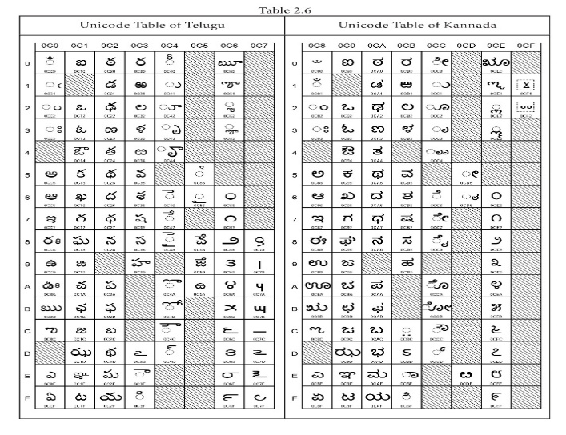
Unicode Character table for Telugu
and Kannada:

Slide 7
Workflow of Indic Transliteration:
Let’s take the Telugu word "ధన్యవాదాలు" (Thank you) as an example:
1. Script Segmentation:
The word is split into graphemes: ["ధ", "న", "్య", "వ", "ా", "ద", "ా", "ల", "ు"].
2. Grapheme-to-Phoneme Mapping:
Each grapheme is mapped to its ITRANS equivalent:
"ధ" → "dha“
"న" → "na“
"్య" → "ya“
"వ" → "va“
"ా" → "ā" (long vowel)
"ద" → "da“
"ా" → "ā“
"ల" → "la“
"ు" → "u“
3. Contextual Postprocessing:
The transliterated text is adjusted for proper pronunciation:
"dha" + "na" + "ya" + "va" + "ā" + "da" + "ā" + "la" + "u" → "dhanyavādālu".

Slide 8
5.Text-to-Speech (TTS)
pyttsx3 is an offline, text-to-speech (TTS) library for Python that supports multiple voices and languages. It uses speech synthesis engines like SAPI5 (Windows), NSSpeechSynthesizer (macOS), and espeak (Linux). The library allows control over speech properties such as rate, volume, and pitch. Unlike cloud-based TTS, pyttsx3 works without an internet connection, making it ideal for offline applications. It is widely used in accessibility tools, voice assistants, and automation projects.

Slide 9
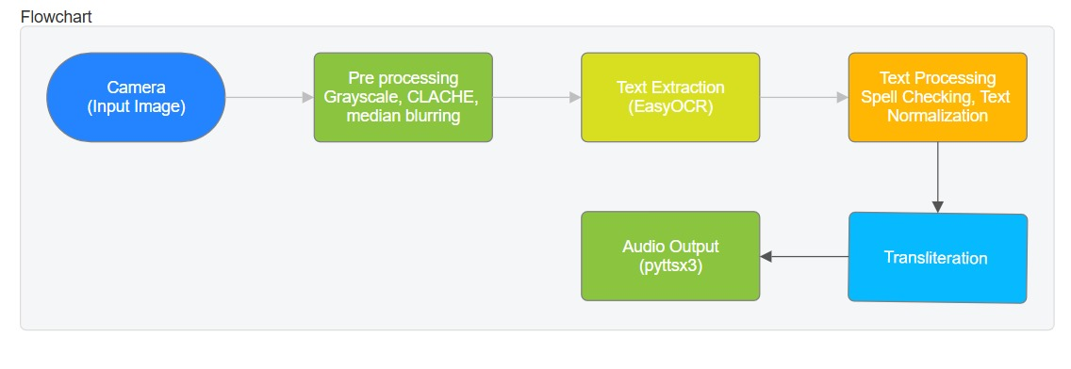
Flow Graph of our proposed idea:
Raspberry Pi
Camera
EasyOCR
Power Supply
TTS
Speaker

Slide 10
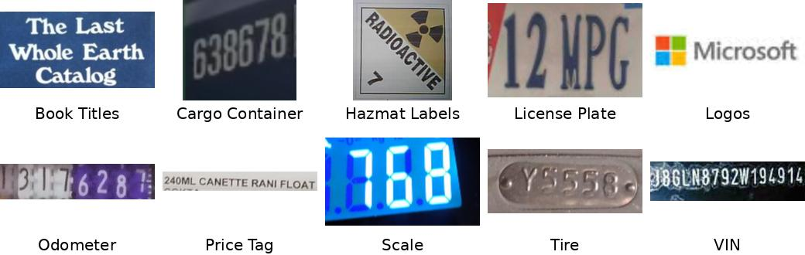
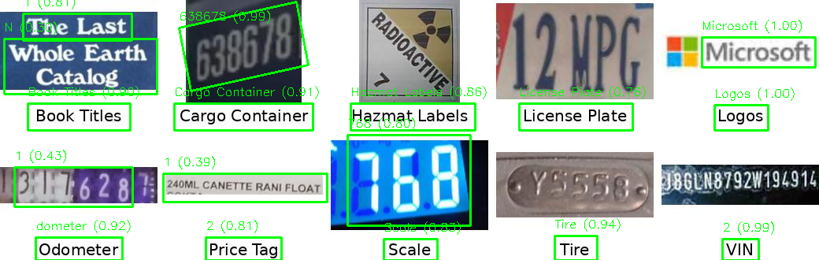
Result:
Sample Images:
Easy OCR processed image:

Slide 11
Accuracy and performance of EasyOCR for different languages
Language | OCR Accuracy (%) | Word Error Rate (WER) | Character Error Rate (CER)
English | 85-92% | 0.08 - 0.15 | 0.05 - 0.12
Telugu | 70-85% | 0.15 - 0.30 | 0.10 - 0.25
Kannada | 68-82% | 0.18 - 0.32 | 0.12 - 0.28

Slide 12
Accuracy of transliteration for Telugu and Kannada Language
Native Text | Expected | IndicTrans Output | Google Output | Accuracy (Levenshtein) | WER | CER
తెలుగు | telugu | telugu | telugu | 100% | 0% | 0%
భాష | bhaasha | bhaasha | bhasha | 93.33% | 10% | 5%
పరిశోధన | parishodhana | parishodhana | parishodhana | 100% | 0% | 0%
Native Text | Expected | IndicTrans Output | Google Output | Accuracy (Levenshtein) | WER | CER
ಕನ್ನಡ | kannada | kannada | kannada | 100% | 0% | 0%
ಭಾಷೆ | bhaashe | bhaashe | bhasha | 93.33% | 10% | 5%
ಸಂಶೋಧನೆ | sanshodhana | sanshodana | sanshodhana | 90.91% | 20% | 9.09%

Slide 13
References:
A. D et al. (2024) ‘Image Text Detection and Documentation Using OCR,’ 2024 International Conference on Smart Systems for Electrical, Electronics, Communication and Computer Engineering (ICSSEECC), Coimbatore, India, 2024, pp. 410-414, doi: 10.1109/ICSSEECC61126.2024.10649443.
Ajantha Devi, V. and Santhosh Baboo, S. (2014) ‘Optical Character Recognition on Tamil Text Image Using Raspberry Pi’, International Journal of Computer Science Trends and Technology (IJCST), Vol.2, Issue 4.

Slide 14
References:
Bhargava, A., Nath, K.V., Sachdeva, P. and Samel, M. (2015) ‘Reading Assistant for the Visually Impaired’, International Journal of Current Engineering and Technology, Vol.5, No.2, pp.454-458.
B. Shi, X. Bai, and C. Yao (2014) ‘An end-to-end trainable neural network for image-based sequence recognition and its application to scene text recognition,’ IEEE Transactions on Pattern Analysis and Machine Intelligence, Vol. 36, No. 11, pp. 2290–2296, Nov. 2014. doi: 10.1109/TPAMI.2014.2347122.
Dhinakaran, D., Selvaraj, D., Udhaya Sankar, S.M., Pavithra, S., Boomika, R. (2023) ‘Assistive System for the Blind with Voice Output Based on Optical Character Recognition’. In: Gupta, D., Khanna, A., Hassanien, A.E., Anand, S., Jaiswal, A. (eds) International Conference on Innovative Computing and Communications. Lecture Notes in Networks and Systems, vol 492. Springer, Singapore. https://doi.org/10.1007/978-981-19-3679-1_1.

Slide 15
References:
Kaur, K. (2016) ‘Machine Transliteration: A Review of Literature’, International Journal of Engineering Trends and Technology (IJETT), Vol.37, No.5, pp.257–260.
Khan, F. and Sharma, G. (2023) ‘Low-Cost OCR System for Assistive Technologies’, Proceedings of the IEEE International Conference on Consumer Electronics (ICCE).
Kumar, A., Sharma, S. and Singh, R. (2021) ‘OCR-Based Assistive System for Blind People’, ResearchGate.
Maithani, M., Meher, D., Gupta, S. (2023) ‘Multilingual Text Recognition System’. In: Chakravarthy, V., Bhateja, V., Flores Fuentes, W., Anguera, J., Vasavi, K.P. (eds) Advances in Signal Processing, Embedded Systems and IoT. Lecture Notes in Electrical Engineering, vol 992. Springer, Singapore. https://doi.org/10.1007/978-981-19-8865-3_9.

Slide 16
References:
Nirmala Kumari, K. and Reddy J, M. (2016) ‘Image Text to Speech Conversion Using OCR Technique in Raspberry Pi’, International Journal of Advanced Research in Electrical, Electronics and Instrumentation Engineering (IJAREEIE), Vol.5, Issue 5.
Patil, Sheetal et al. (2023) ‘Vehicle Number Plate Detection using YoloV8 and EasyOCR.’ 2023 14th International Conference on Computing Communication and Networking Technologies (ICCCNT), pp.1-4.
Raja Venkatesan, Karthigaa, M., Ranjith, P., Arunkumar, C. and Gowtham, M. (2016) ‘Intelligent Translate System for Visually Challenged People’, International Journal for Scientific Research & Development (IJSRD), Vol.3, Issue 12.
Raj, Y. and Laddagiri, B. (2022) ‘MATra: A Multilingual Attentive Transliteration System for Indian Scripts’, arXiv Preprint.
Sawant, P., Bapardekar, M., Bhutiya, L. et al. (2024) ‘Advanced Text-to-Speech Reading Device for Visually Impaired Individuals’, SSRN.

Slide 17
References:
MWP Maduranga, PADV Pannala, NT Jayatilake, and SPARS Jayathilake (2022) ‘Design and Development of Wearable Text Reading Device for Visually Impaired People,’ Annual Conference 2022 - IET Sri Lanka Network, General Sir John Kotelawala Defence University, Ratmalana, Sri Lanka, 2022.
S. V. Dahiphale and S. J. Nandedkar (2024) ‘Image Text to Speech Conversion with Raspberry-Pi Using OCR,’ International Research Journal of Engineering and Technology (IRJET), Vol. 11, No. 4, pp. 1-4, Apr. 2024.
V. Narayan and S. Deb (2024) ‘Newspaper Reading in Kannada and English for the Visually Impaired Using Raspberry Pi,’ 2024 2nd International Conference on Recent Trends in Microelectronics, Automation, Computing and Communications Systems (ICMACC), Hyderabad, India, 2024, pp. 574-580,doi: 10.1109/ICMACC62921.2024.10894674

Slide 18
THANK YOU!

